Slide 1
Data structures

Slide 2
What is Data Structure
Data Structure can be defined as the group of data elements which provides an efficient way of storing and organizing data in the computer so that it can be used efficiently.
examples of Data Structures are arrays, Linked List, Stack, Queue, etc.
Data Structures are widely used in almost every aspect of Computer Science i.e. Operating System, Compiler Design, Artificial intelligence, Graphics and many more.
Data Structures are the main part of many computer science algorithms as they enable the programmers to handle the data in an efficient way.
It plays a vital role in enhancing the performance of a software or a program as the main function of the software is to store and retrieve the user’s data as fast as possible
Data Structure= Organized Data + Allowed Operations

Slide 3
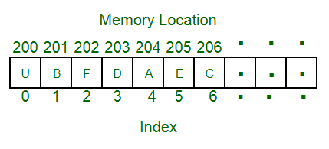
Data Structure
A data structure is a particular way of organizing data in a computer so that it can be used effectively.
For example, we can store a list of items having the same data-type using the array data structure.

Slide 4
The representation of particular data structure in the main memory of a computer is called as storage structure.
The storage structure representation in auxiliary memory is called as file structure.
It is define as the way of storing and manipulating data in organized form so that it can be used efficiently
Data Structure mainly specifies the following four things:
1)organization of data 2)accessing method 3)degree of associativity 4) processing alternative for information
Algorithm + Data Structure = Program
Data Structure study Covers the following points
1) Amount of memory require to store
2) Amount of time require to process
3) Representation of data in memory
4) Operations performed on data

Slide 5
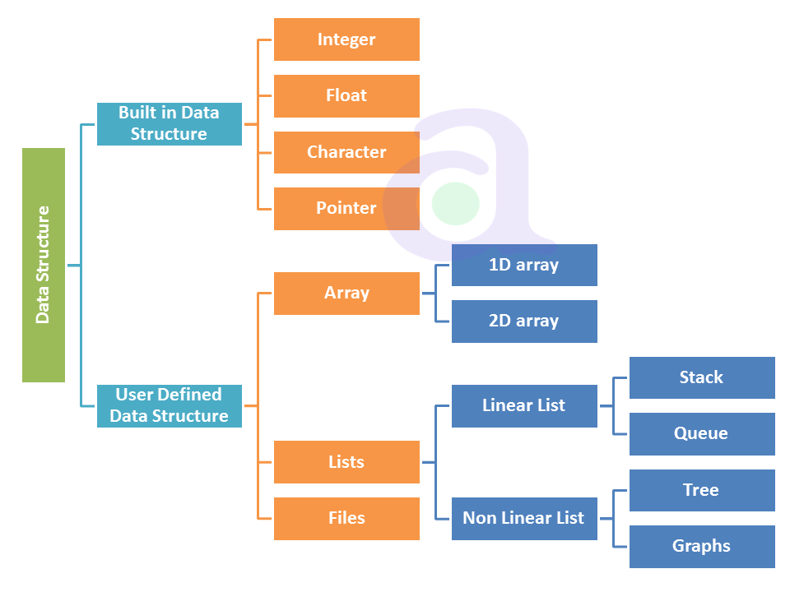
Types Of DS
The DS are divided into two types:
Primitive
Non primitive
Non primitive divided into two type
Linear DS
Non linear DS

Slide 6
Applications of Arrays
Arrays
Arrangement of leader-board of a game can be done simply through arrays to store the score and arrange them in descending order to clearly make out the rank of each player in the game.
2D arrays, commonly known as, matrix, are used in image processing.
It is also used in speech processing, in which each speech signal is an array.

Slide 7
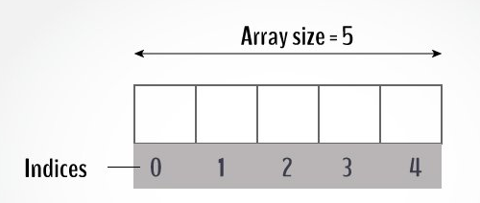
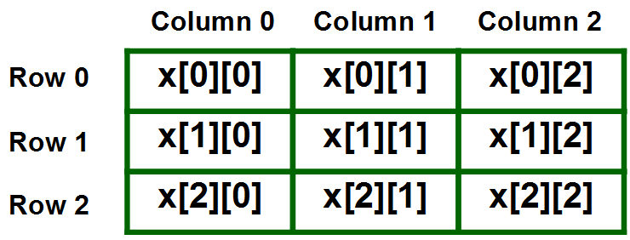

Slide 8
Applications of the linked list
Images in a location are linked with each other. So, an image viewer software uses a linked list to view the previous and the next images using the previous and next buttons.
Web pages can be accessed using the previous and the next URL links which are linked using linked list.
The music players also use the same technique to switch between music.
To keep the track of turns in a multi player game, a circular linked list is used.

Slide 9
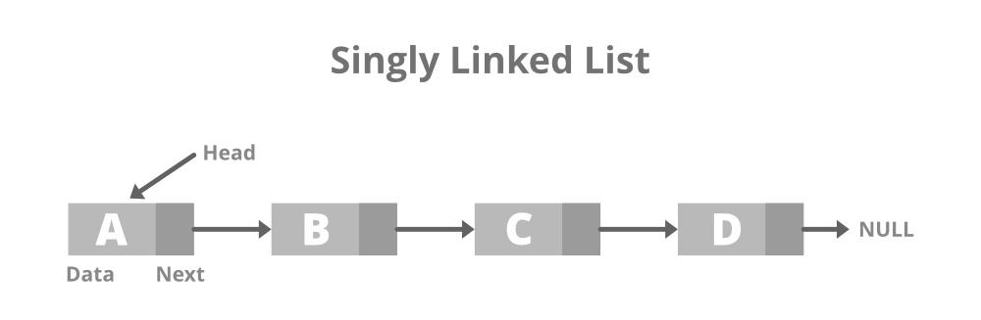
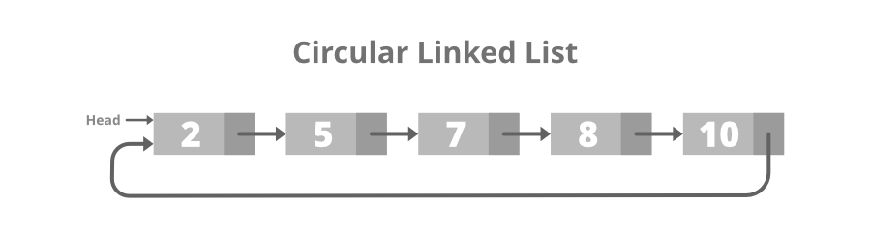
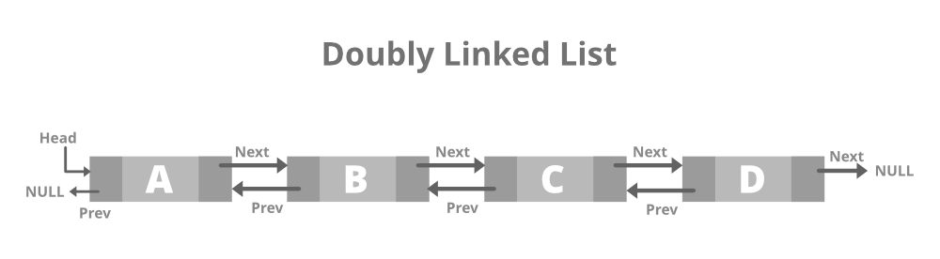
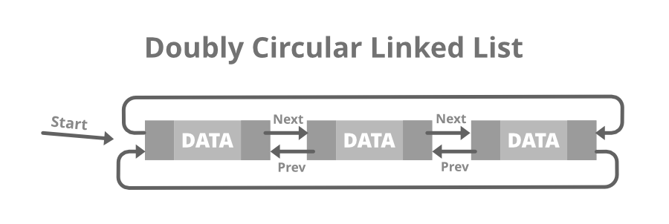

Slide 10
Applications of a stack
Some Applications of a stack are:
Converting infix to postfix expressions.
Undo operation is also carried out through stacks.
Syntaxes in languages are parsed using stacks.
It is used in many virtual machines like JVM.
Forward – backward surfing in browser
History of visited websites
Message logs and all messages you get are arranged in stack
Call logs, E-mails, Google photos’ any gallery , YouTube downloads, Notifications ( latest appears first )

Slide 11
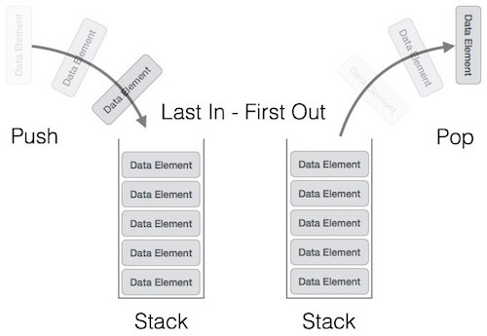

Slide 12
Applications of Queue
Operating System uses queue for job scheduling.
To handle congestion in networking queue can be used.
Data packets in communication are arranged in queue format.
Sending an E-mail, it will be queued
server while responding request
Uploading and downloading photo’s, first kept for uploading/downloading will completed first (Not if there is threading)
Most of internet requests and processes uses queue
While switching multiple applications, windows uses circular queue.

Slide 13
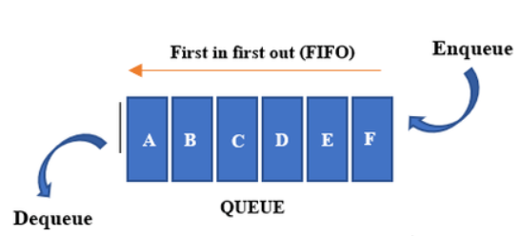

Slide 14
Applications of a Graph
Facebook’s Graph API uses the structure of Graphs. (The Graph API is the primary way to get data into and out of the Facebook platform. It's an HTTP-based API that apps can use to programmatically query data, post new stories, manage ads, upload photos, and perform a wide variety of other tasks.)
Google’s Knowledge Graph also has to do something with Graph. ( knowledge base that represents semantic relations between concepts in a network.)
Dijkstra algorithm or the shortest path first algorithm also uses graph structure to finding the smallest path between the nodes of the graph.
GPS navigation system also uses shortest path APIs.
Networking components has huge application of graph
Facebook, Instagram and all social media networking sites every user is Node
Data organization
Notes:
The Graph API is named after the idea of a "social graph" — a representation of the information on Facebook. It's composed of nodes, edges, and fields. Typically you use nodes to get data about a specific object, use edges to get collections of objects on a single object, and use fields to get data about a single object or each object in a collection.

Slide 15
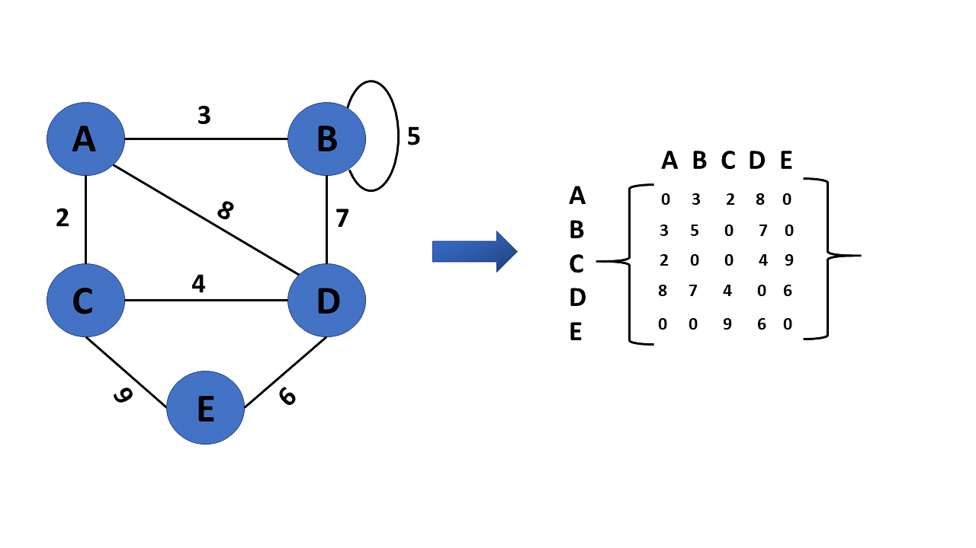

Slide 16
Applications of the trees
XML Parser uses tree algorithms.
Decision-based algorithm is used in machine learning which works upon the algorithm of tree.
Databases also uses tree data structures for indexing.
Domain Name Server(DNS) also uses tree structures.
File explorer/my computer of mobile/any computer
BST used in computer Graphics
Posting questions on websites like Quora, the comments are child of questions
Notes:
https://www.2braces.com/c-questions/for-loop-questions-c-3

Slide 17
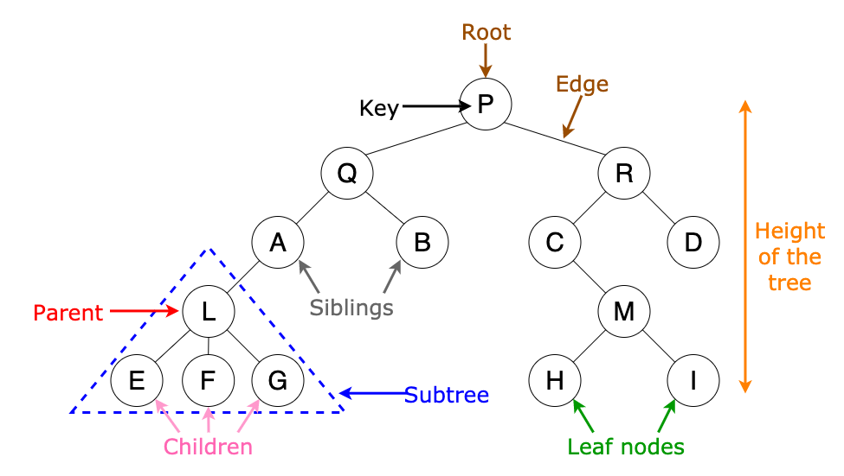

Slide 18
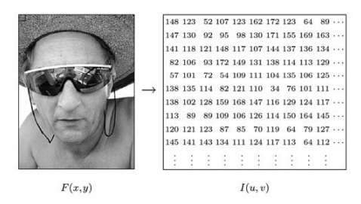

Slide 19
DATA TYPES A particular kind of data item, as defined by the values it can take, the Programming language used, or the operations that can be performed on it.
Primitive Data Structure
Primitive Data Structure are basic structure and directly operated upon by machine instructions.
Primitive data structures have different representations on different computers.
Integers, floats, character and pointers are example of primitive data structures.
These data types are available in most programming languages as built in type.
Integer: It is a data type which allows all values without fraction part. We can used it for whole numbers.
Float: It is a data type which is use for storing fraction numbers.
Character: It is a data type which is used for character values.
Pointer: A variable that hold memory address of another variable are called pointer.

Slide 20
Non Primitive Data Type
These are more sophisticated data structures.
These are derived from primitive data structure.
The non – primitive data structures emphasize structuring of a group of homogeneous or heterogeneous data items.
Example of non – primitive data types are Array, List, and File etc.
A non – primitive data type is further divided into Linear and non – Linear data structure.
Array: An array is a fixed size sequenced collection of elements of the same data type.
List: An ordered set containing variable number of elements is called as List.
File: A file is a collection of logically related information. It can be viewed as a large list of records consisting of various fields.

Slide 21
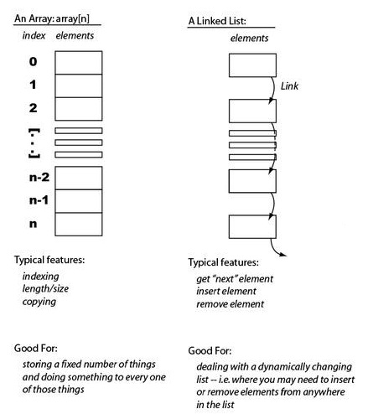
Linear Data Structures
A linear data structure simply means that it is a storage format of the data in the memory in which the data are arranged in contiguous blocks of memory.
Example is the array of characters it represented by one character after another.
In the linear data structure, member elements form a sequence in the storage.
There are two ways to represent a linear data structure in memory.
static memory allocation
dynamic memory allocation

Slide 22
Operations on Data structures
Traversing
Searching
Insertion
Deletion
Selection
Update
Sort
Merge
Split

Slide 23
Operation on Data Structures Design of efficient data structure must take operations to be performed on the DS into account. The most commonly used operations on DS are broadly categorized into following types
Create: This operation results in reserving memory for program elements. This can be done by declaration statement Creation of DS may take place either during compile-time or run-time.
Destroy: This operation destroy memory space allocated for specified data structure .
Selection: This operation deals with accessing a particular data within a data structure.
Updation: It updates or modifies the data in the data structure.
Searching: It finds the presence of desired data item in the list of data items, it may also find locations of all elements that satisfy certain conditions.
Sorting: This is a process of arranging all data items in a DS in particular order, for example either ascending order or in descending order.
Splitting: It is a process of partitioning single list to multiple list.
Merging: It is a process of combining data items of two different sorted list into single sorted list.
Traversing: It is a process of visiting each and every node of a list in systematic manner.

Slide 24
Linear Search

Slide 25
Program 1 – Menu driven program to implement linear search and binary search and find the location of an element on its first occurance
Main Function
Step 1 : List the choices
Step 2: Enter the choice
Step 3: Validate the choice
Step 4: if option is 1 then call linear() function; 2 calls binary() function; 3 exits

Slide 26
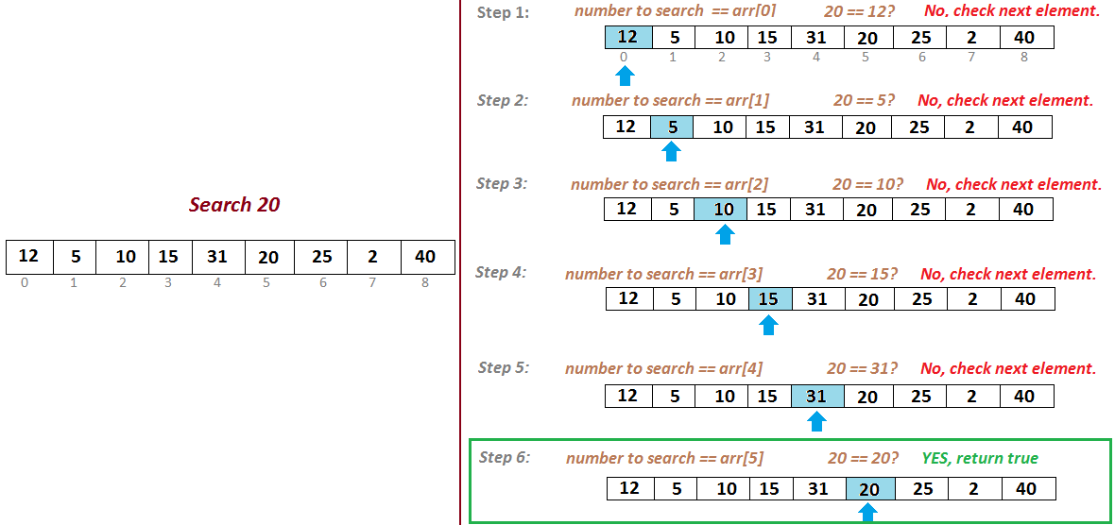

Slide 28
Binary Search

Slide 29
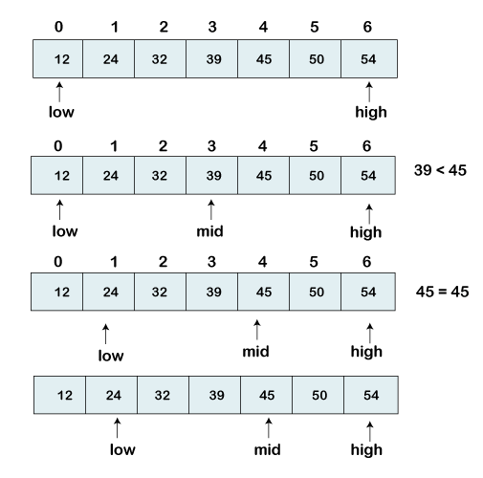

Slide 30
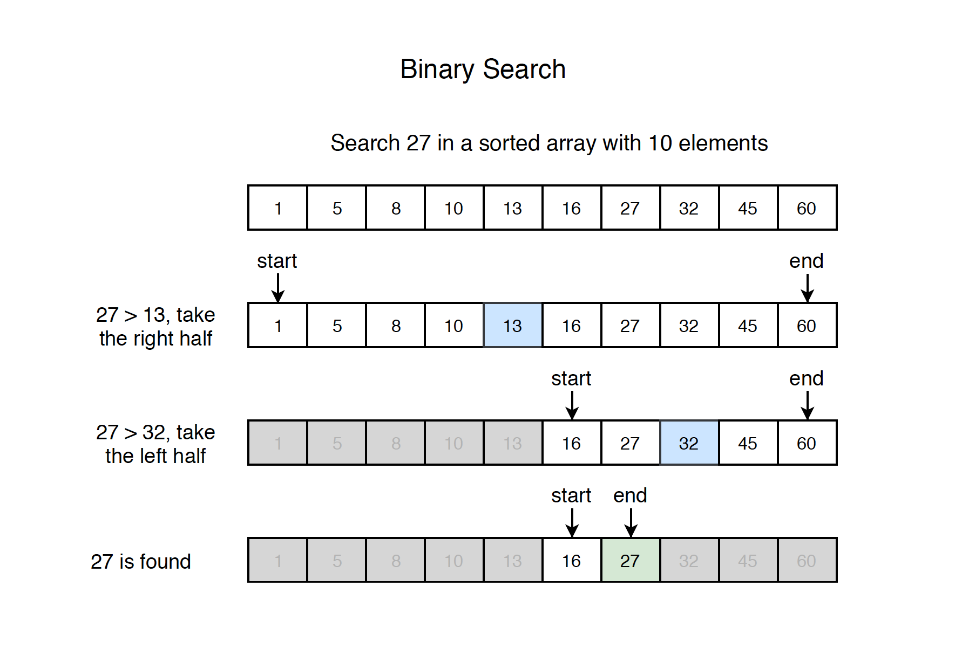

$$<$$

Slide 31
Quicksort
Quick sort is a fast sorting algorithm used to sort a list of elements. Quick sort algorithm is invented by C. A. R. Hoare.
The quick sort algorithm attempts to separate the list of elements into two parts and then sort each part recursively. That means it use divide and conquer strategy.
In quick sort, the partition of the list is performed based on the element called pivot. Here pivot element is one of the elements in the list.
The list is divided into two partitions such that "all elements to the left of pivot are smaller than the pivot and all elements to the right of pivot are greater than or equal to the pivot".

Slide 32
Steps of quick sort
Step by Step Process
In Quick sort algorithm, partitioning of the list is performed using following steps...
Step 1 - Consider the first element of the list as pivot (i.e., Element at first position in the list).
Step 2 - Define two variables i and j. Set i and j to first and last elements of the list respectively.
Step 3 - Increment i until list[i] > pivot then stop.
Step 4 - Decrement j until list[j] < pivot then stop.
Step 5 - If i < j then exchange list[i] and list[j].
Step 6 - Repeat steps 3,4 & 5 until i > j.
Step 7 - Exchange the pivot element with list[j] element.

Slide 33
Merge sort

Slide 34
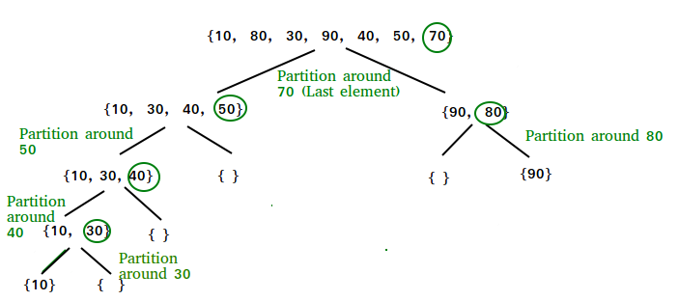
Quick sort

Slide 35
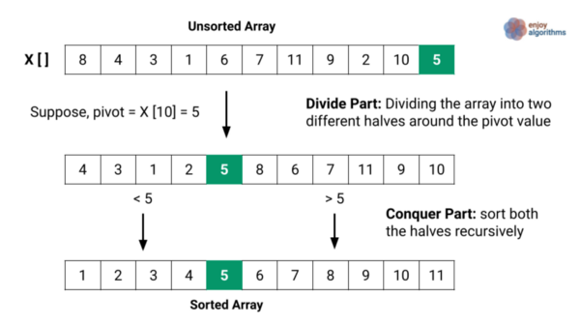

Slide 36
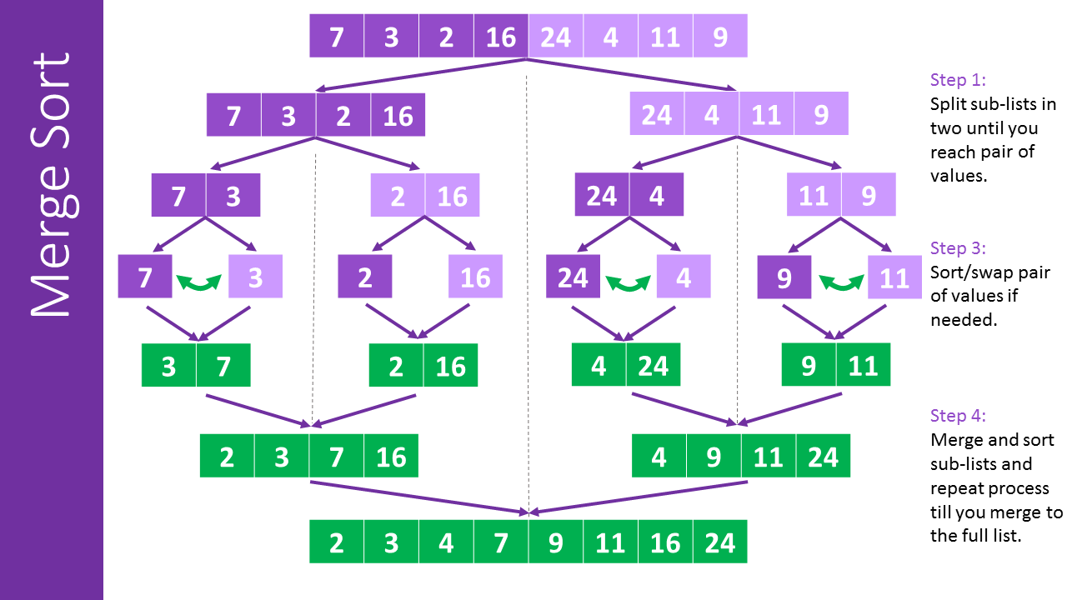

Slide 37
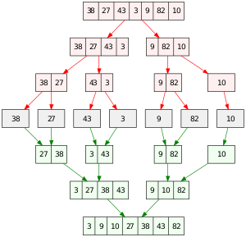
Merge Sort

Slide 38
Linear List

Slide 40
List Operations:
• Traversal: Traversal of a data structure means processing all the data elements of it, sequentlly.
• Insertion: Insertion means addition of a new data element in a data structure.
• Deletion: Deletion means removal of a data element from a data structure. The data element
is searched for before its removal.
• Searching: Searching involves searching for the specified data element in a data structure.
• Sorting: Arranging data elements of a data structure in a specified order is called sorting.
• Merging: Combining elements of two similar data structures to form a new data structure of same type, is called merging.

Slide 41
Insert an element
Algorithm InsertLA (DATA, N, ITEM, LOC)
Desc: This algorithm inserts new element ITEM in linear array DATA with N elements
If LOC=1 it means the element has to insert in beginning
If LOC =N+1 it means the element have to be inserted at the end
If LOC = J it means the elements have to be inserted at Jth Location
Begin
Step 1: [Initialize counter I with index of last element] I=N
Step 2: While I >=LOC repeat steps 3 and 4
Step 3: [Move the current element one position backwards]
DATA[I+1]=DATA[I]
Step 4: [Decrement counter I]
I=I-1
Step 5:[Insert new element at the Location]
DATA[LOC]=ITEM
Step 6:[ Update total under of array elements]
N=N+1
Exit
Notes:
https://csveda.com/data-structure/insertion-in-linear-array/

Slide 42
It is a process of deleting a particular element from an array. If an element to be deleted ith location then all elements from the (i+1)th location we have to be shifted one step towards left. So (i+1)th element is copied to ith location and (i+2)th to (i+1)th location and so on.
Algorithm: In this algorithm a value is being deleted from ith location of an array Reg[N]. Let us assume that last element in the array is at Mth position.
Steps
1. Back=i
2. While (Back<M) repeat 3 and 4
3. Reg[Back]= Reg[Back+1]
4. Back= Back+1
5. M=M-1
6. End

Slide 43
There are 4 library functions provided by C defined under <stdlib.h> header file to facilitate dynamic memory allocation in C programming. They are:
malloc()
calloc()
free()
realloc()

Slide 44
malloc() method
The “malloc” or “memory allocation” method in C is used to dynamically allocate a single large block of memory with the specified size.
It returns a pointer of type void which can be cast into a pointer of any form. It doesn’t Iniatialize memory at execution time so that it has initializes each block with the default garbage value initially.
ptr = (cast-type*) malloc(byte-size)
For Example:
ptr = (int*) malloc(100 * sizeof(int));

Slide 45
C calloc() method
“calloc” or “contiguous allocation” method in C is used to dynamically allocate the specified number of blocks of memory of the specified type. it is very much similar to malloc() but has two different points and these are:
It initializes each block with a default value ‘0’.
It has two parameters or arguments as compare to malloc().
ptr = (cast-type*)calloc(n, element-size);
n= no. of elements and
element-size is the size of each element.
ptr = (float*) calloc(25, sizeof(float));

Slide 46
free() method
free() method in C is used to dynamically de-allocate the memory.
The memory allocated using functions malloc() and calloc() is not de-allocated on their own. Hence the free() method is used, whenever the dynamic memory allocation takes place. It helps to reduce wastage of memory by freeing it.
Syntax:
free(ptr);

Slide 47
realloc() method
“realloc” or “re-allocation” method in C is used to dynamically change the memory allocation of a previously allocated memory. In other words, if the memory previously allocated with the help of malloc or calloc is insufficient, realloc can be used to dynamically re-allocate memory. re-allocation of memory maintains the already present value and new blocks will be initialized with the default garbage value.
ptr = realloc(ptr, newSize);
where ptr is reallocated with new size 'newSize'.

Slide 48
Linked List
A linked list is a non-sequential collection of data items. It is a dynamic data structure. For every data item in a linked list, there is an associated pointer that would give the memory location of the next data item in the linked list.
The data items in the linked list are not in consecutive memory locations. They may be anywhere, but the accessing of these data items is easier as each data item contains the address of the next data item.

Slide 49
Advantages of linked lists
1. Linked lists are dynamic data structures. i.e., they can grow or shrink during the execution of a program.
2. Linked lists have efficient memory utilization. Here, memory is not pre-allocated. Memory is allocated whenever it is required and it is de-allocated (removed) when it is no longer needed.
3. Insertion and Deletions are easier and efficient. Linked lists provide flexibility in inserting a data item at a specified position and deletion of the data item from the given position.
4. Many complex applications can be easily carried out with linked lists.

Slide 50
Uses of Linked List
The list is not required to be contiguously present in the memory. The node can reside any where in the memory and linked together to make a list. This achieves optimized utilization of space.
list size is limited to the memory size and doesn't need to be declared in advance.
Empty node can not be present in the linked list.
We can store values of primitive types or objects in the singly linked list.

Slide 51
Why use linked list over array?
Array has the following limitations:
The size of array must be known in advance before using it in the program.
Increasing size of the array is a time taking process. It is almost impossible to expand the size of the array at run time.
All the elements in the array need to be contiguously stored in the memory. Inserting any element in the array needs shifting of all its predecessors.

Slide 52
Disadvantages of linked lists
It consumes more space because every node requires a additional pointer to store address of the next node.
Searching a particular element in list is difficult and also time consuming.

Slide 53
Types of Linked Lists
Single Linked List.
Double Linked List.
Circular Linked List.
Circular Double Linked List.

Slide 54
A single linked list is one in which all nodes are linked together in some sequential manner. Hence, it is also called as linear linked list.
A double linked list is one in which all nodes are linked together by multiple links which helps in accessing both the successor node (next node) and predecessor node (previous node) from any arbitrary node within the list. Therefore each node in a double linked list has two link fields (pointers) to point to the left node (previous) and the right node (next). This helps to traverse in forward direction and backward direction.
A circular linked list is one, which has no beginning and no end. A single linked list can be made a circular linked list by simply storing address of the very first node in the link field of the last node.
A circular double linked list is one, which has both the successor pointer and predecessor pointer in the circular manner.

Slide 55
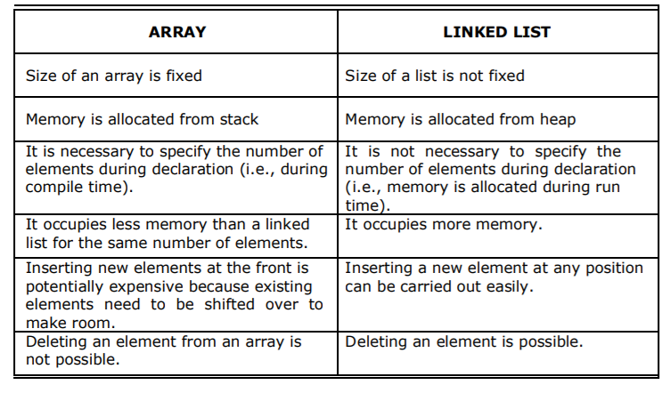
Comparison between array and linked list

Slide 56

Applications of linked list
1. Linked lists are used to represent and manipulate polynomial. Polynomials are expression containing terms with non zero coefficient and exponents. For
example:
2. Represent very large numbers and operations of the large number such as addition, multiplication and division.
3. Linked lists are to implement stack, queue, trees and graphs.
4. Implement the symbol table in compiler construction
struct node
{
int coeff,pow;
struct node *next;
}
Notes:
https://scitech105.blogspot.com/2016/03/c-program-to-implement-polynomial.html

Slide 57
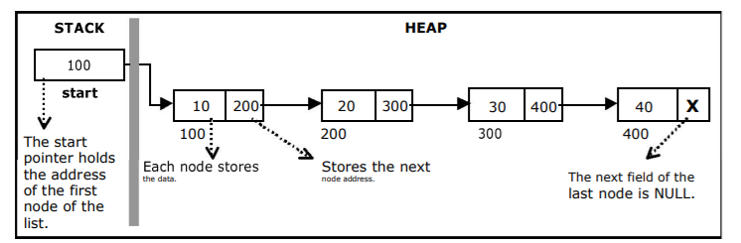
Single Linked List

Slide 58
Implementation of Single Linked List
Before writing the code to build the above list, we need to create a start node, used to create and access other nodes in the linked list.
Creating a structure with one data item and a next pointer, which will be pointing to next node of the list. This is called as self-referential structure.
Initialize the start pointer to be NULL.

Slide 59
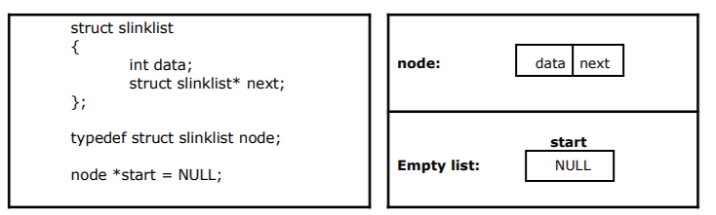

Slide 60
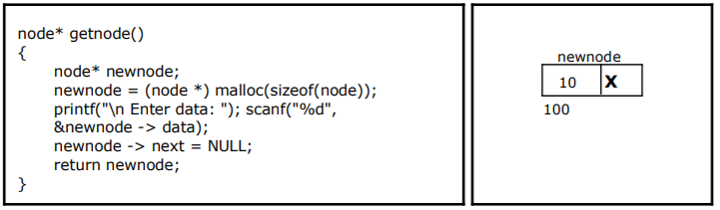
Creating a node for Single Linked List

Slide 61
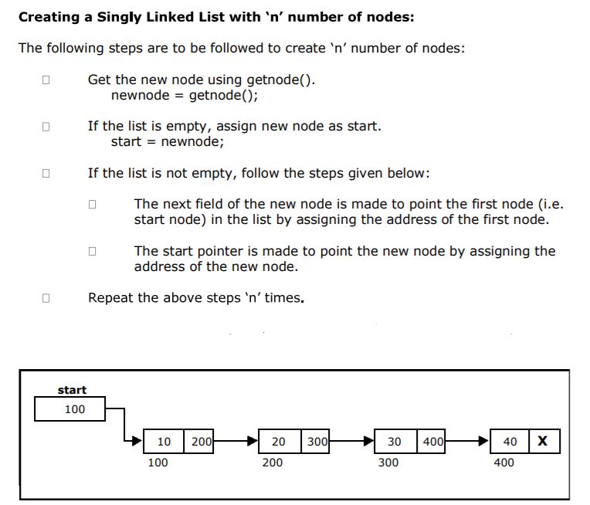

Slide 62
void createlist(int n)
{
int i;
node * newnode;
node *temp;
for(i = 0; i < n ; i+ +)
{
newnode = getnode();
if(start = = NULL)
{
start = new node;
}
else
{
temp = start;
while(temp - > next != NULL)
temp = temp - > next;
temp - > next = new node;
}
}
}

Slide 63
Insertion of a Node
Inserting a node at the beginning.
Inserting a node at the end.
Inserting a node at intermediate position.
Inserting a node at the beginning:
The following steps are to be followed to insert a new node at the beginning of the list:
Get the new node using getnode().
newnode = getnode();
If the list is empty then start = newnode.
If the list is not empty, follow the steps given below:
newnode -> next = start;
start = newnode;

Slide 64
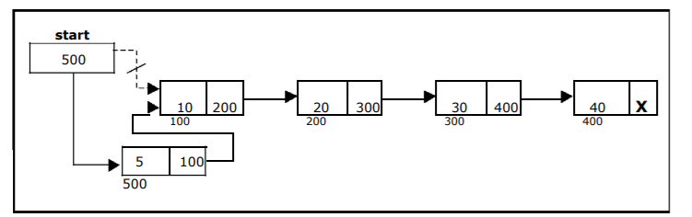
void insert_at_beg()
{
node *newnode;
newnode = getnode();
if(start == NULL)
{
start = newnode;
}
else
{
newnode -> next = start;
start = newnode;
}
}

Slide 65
Inserting a node at the end
The following steps are followed to insert a new node at the end of the list:
Get the new node using getnode()
newnode = getnode();
If the list is empty then start = newnode.
If the list is not empty follow the steps given below:
temp = start;
while(temp -> next != NULL)
temp = temp -> next;
temp -> next = newnode;
void insert_at_end()
{
node *newnode, *temp;
newnode = getnode();
if(start == NULL)
{
start = newnode;
}
else
{
temp = start;
while(temp -> next != NULL)
temp = temp -> next;
temp -> next = newnode;
}
}

Slide 66
Inserting a node at intermediate position
Get the new node using getnode().
newnode = getnode();
Ensure that the specified position is in between first node and last node. If not, specified position is invalid. This is done by countnode() function.
Store the starting address (which is in start pointer) in temp and prev
pointers. Then traverse the temp pointer upto the specified position followed by prev pointer.
After reaching the specified position, follow the steps given below:
prev -> next = newnode;
newnode -> next = temp;

Slide 67
void insert_at_mid()
{
node *newnode, *temp, *prev;
int pos, nodectr, ctr = 1;
newnode = getnode();
printf("\n Enter the position: ");
scanf("%d", &pos);
nodectr = countnode(start);
if(pos > 1 && pos < nodectr)
{
temp = prev = start;
while(ctr < pos)
{
prev = temp;
temp = temp -> next;
ctr++;
}
prev -> next = newnode;
newnode -> next = temp;
}
else
{
printf("position %d is not a middle position", pos);
}
}

Slide 68
Deletion of a node
Another primitive operation that can be done in a singly linked list is the deletion of a node. Memory is to be released for the node to be deleted. A node can be deleted from the list from three different places namely.
Deleting a node at the beginning.
Deleting a node at the end.
Deleting a node at intermediate position

Slide 69
Deleting a node at the beginning
void delete_at_beg()
{
node *temp;
if(start == NULL)
{
printf("\n No nodes are exist..");
return ;
}
else
{
temp = start;
start = temp -> next;
free(temp);
printf("\n Node deleted ");
}
}
The following steps are followed, to delete a node at the beginning of the list:
If the list is not empty, follow the steps given below:
temp = start;
start = start -> next;
free(temp);

Slide 70
Deleting a node at the end
void delete_at_last()
{
node *temp, *prev;
if(start == NULL)
{
printf("\n Empty List..");
return ;
}
else
{
temp = start;
prev = start;
while(temp -> next != NULL)
{
prev = temp;
temp = temp -> next;
}
prev -> next = NULL;
free(temp);
printf("\n Node deleted ");
}
}
The following steps are followed to delete a node at the end of the list:
If the list is empty, display error message
If the list is not empty, follow the steps given below:
temp = prev = start;
while(temp -> next != NULL)
{
prev = temp;
temp = temp -> next;
}
prev -> next = NULL;
free(temp);

Slide 71
Deleting a node at Intermediate position
If the list is empty, then display ‘empty list message’
If the list is not empty, follow the steps given below.
if(pos > 1 && pos < nodectr)
{
temp = prev = start;
ctr = 1;
while(ctr < pos)
{
prev = temp;
temp = temp -> next;
ctr++;
}
prev -> next = temp -> next;
free(temp);
printf("\n node deleted..");

Slide 72
void delete_at_mid()
{
int ctr = 1, pos, nodectr;
node *temp, *prev;
if(start == NULL)
{
printf("\n Empty List..");
return ;
}
else
{
printf("\n Enter position of node to delete: ");
scanf("%d", &pos);
nodectr = countnode(start);
if(pos > nodectr)
{
printf("\nThis node doesnot exist");
}
if(pos > 1 && pos < nodectr)
{
temp = prev = start;
while(ctr < pos)
{
prev = temp;
temp = temp -> next;
ctr ++;
}
prev -> next = temp -> next;
free(temp);
printf("\n Node deleted..");
}
else
{
printf("\n Invalid position..");
getch();
}
}
}

Slide 73
Counting the Number of Nodes:
The following code will count the number of nodes exist in the list using recursion.
int countnode(node *st)
{
if(st = = NULL)
return 0;
else
return(1 + countnode(st - > next));
}

Slide 74
Traversal and displaying a list (Left to Right)
void traverse()
{
node *temp;
temp = start;
printf("\n The contents of List (Left to Right):
\n");
if(start == NULL )
printf("\n Empty List");
else
{
while (temp != NULL)
{
printf("%d ->", temp -> data);
temp = temp -> next;
}
}
printf("X");
}

Slide 75
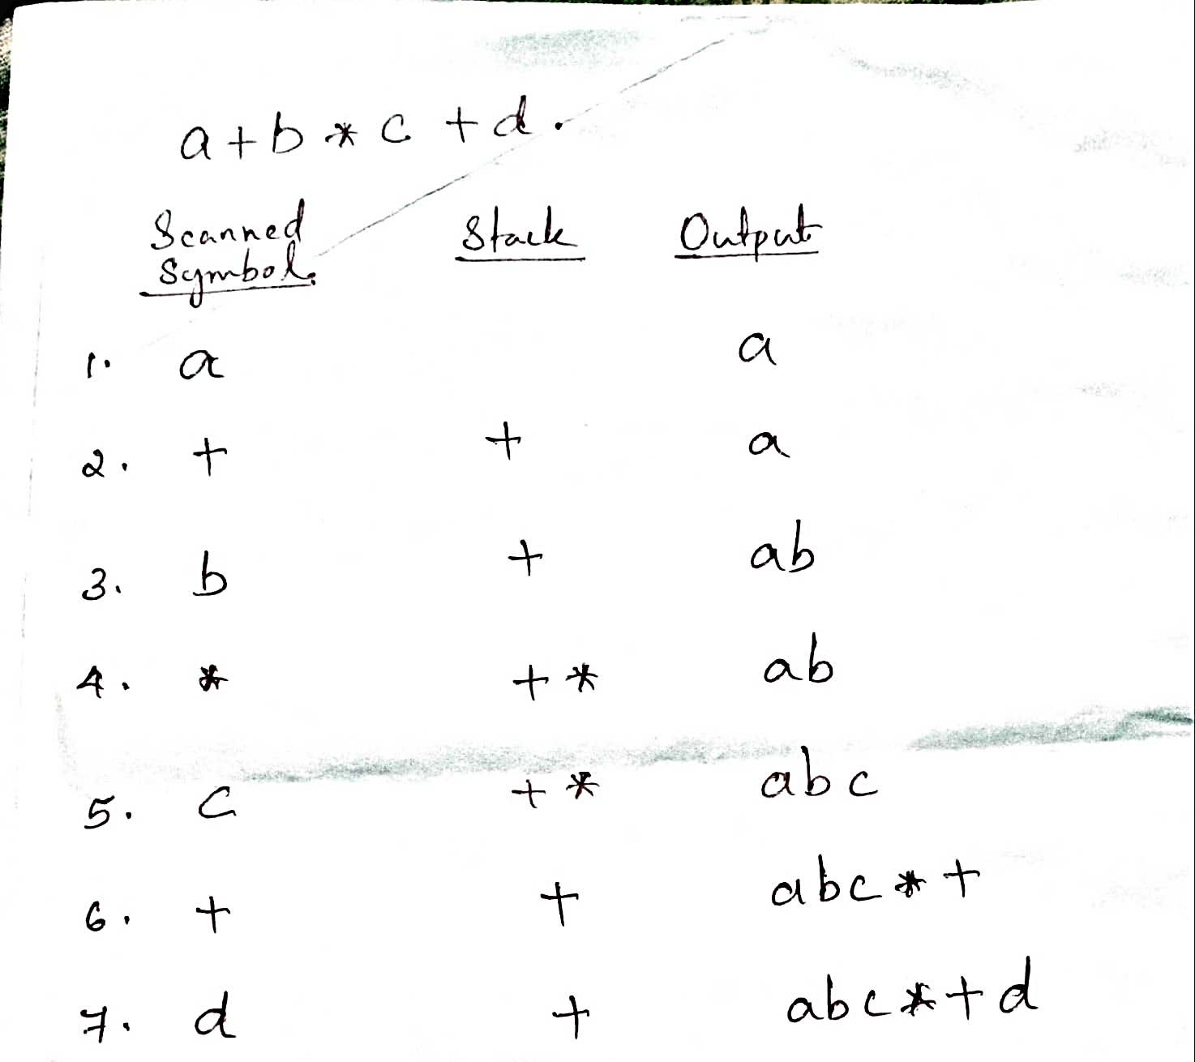
Infix to Postfix

Slide 76
Infix to Postfix
Algorithm 1. Scan the infix expression from left to right. 2. If the scanned character is an operand, output it. 3. Else, 1 If the precedence of the scanned operator is greater than the precedence of the operator in the stack(or the stack is empty or the stack contains a ‘(‘ ), push it. 2 Else, Pop all the operators from the stack which are greater than or equal to in precedence than that of the scanned operator. After doing that Push the scanned operator to the stack. (If you encounter parenthesis while popping then stop there and push the scanned operator in the stack.) 4. If the scanned character is an ‘(‘, push it to the stack. 5. If the scanned character is an ‘)’, pop the stack and output it until a ‘(‘ is encountered, and discard both the parenthesis. 6. Repeat steps 2-6 until infix expression is scanned. 7. Print the output 8. Pop and output from the stack until it is not empty.

Slide 77
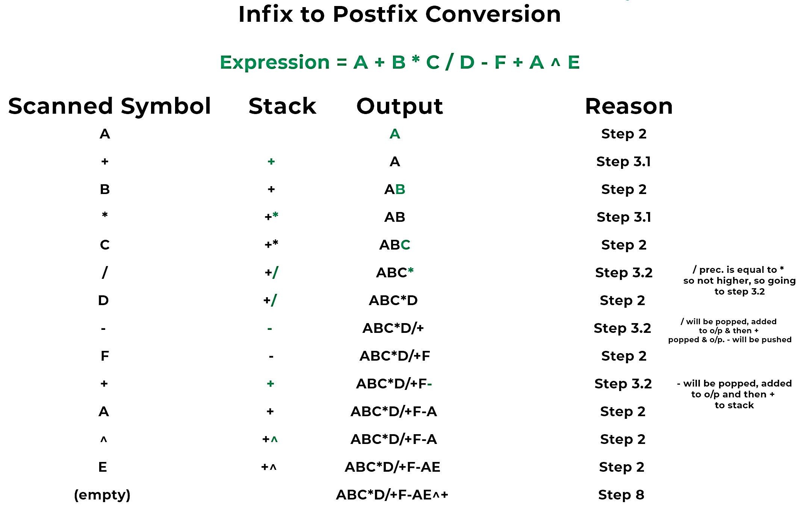

Slide 78
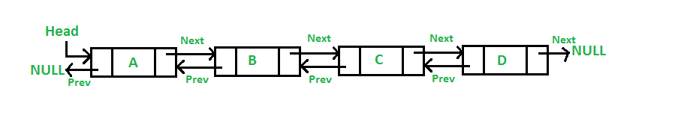
Doubly Linked List
A Doubly Linked List (DLL) contains an extra pointer, typically called previous pointer, together with next pointer and data which are there in singly linked list.

Slide 79
Advantages over singly linked list 1) A DLL can be traversed in both forward and backward direction. 2) The delete operation in DLL is more efficient if pointer to the node to be deleted is given. 3) We can quickly insert a new node before a given node. In singly linked list, to delete a node, pointer to the previous node is needed. To get this previous node, sometimes the list is traversed. In DLL, we can get the previous node using previous pointer.

Slide 80
Disadvantages over singly linked list 1) Every node of DLL Require extra space for an previous pointer. It is possible to implement DLL with single pointer though 2) All operations require an extra pointer previous to be maintained. For example, in insertion, we need to modify previous pointers together with next pointers.

Slide 81
Creating a Node in Doubly Linked List
Each node in a doubly linked list has data as well pointers. Therefore, we use a structure to create the node. The structure template for the node looks as follows:
struct Node
{
int data; //The data point
struct Node *Prev; //Pointer to the previous node
struct Node *Next; //Pointer to the next node
};

Slide 82
Traversal in a Doubly Linked List
List_traversal(struct Node *Head)
{
Prev = (struct Node *)malloc(sizeof(struct Node));
Next = (struct Node *)malloc(sizeof(struct Node));
if(Head == NULL) //If the list is empty
return;
while(Next->data != NULL)
{
Print(Next->data); //The display operation
}
}

Slide 83
Insertion A node can be added in four ways 1) At the front of the DLL 2) After a given node. 3) At the end of the DLL 4) Before a given node.

Slide 84
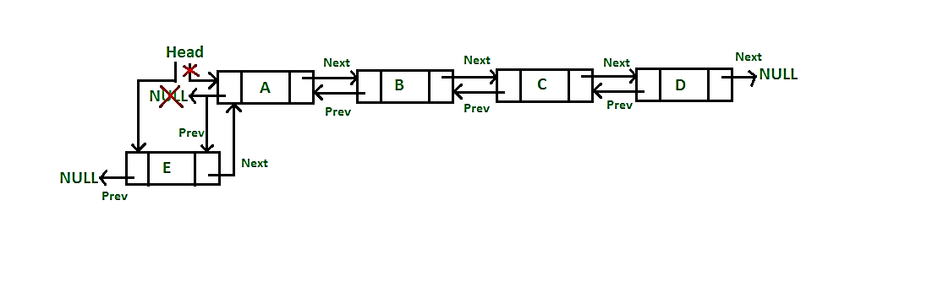
Insert a node at front (5 Steps)
/* Given a reference (pointer to pointer) to the head of a list
and an int, inserts a new node on the front of the list. */
void push(struct Node** head_ref, int new_data)
{
/* 1. allocate node */
struct Node* new_node = (struct Node*)malloc(sizeof(struct Node));
/* 2. put in the data */
new_node->data = new_data;
/* 3. Make next of new node point to earlier head and previous as NULL */
new_node->next = (*head_ref);
new_node->prev = NULL;
/* 4. change prev of earlier head node to new node */
if ((*head_ref) != NULL)
(*head_ref)->prev = new_node;
/* 5. move the head to point to the new node */
(*head_ref) = new_node;
}

Slide 85
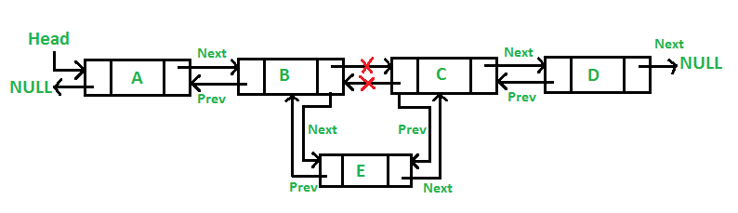
Add a node after a given node

Slide 86
Add a node after a given node
/* Given a node as prev_node, insert a new node after the given node */
void insertAfter(struct Node* prev_node, int new_data)
{
/*1. check if the given prev_node is NULL */
if (prev_node == NULL) {
printf("the given previous node cannot be NULL");
return;
}
/* 2. allocate new node */
struct Node* new_node = (struct Node*)malloc(sizeof(struct Node));
/* 3. put in the data */
new_node->data = new_data;
/* 4. Make next of new node as next of prev_node */
new_node->next = prev_node->next;
/* 5. Make the next of prev_node as new_node */
prev_node->next = new_node;
/* 6. Make prev_node as previous of new_node */
new_node->prev = prev_node;
/* 7. Change previous of new_node's next node */
if (new_node->next != NULL)
new_node->next->prev = new_node;
}

Slide 87
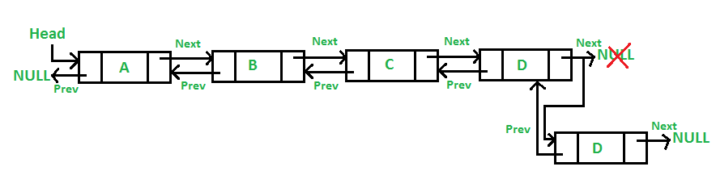
Add a node at the end

Slide 88
void append(struct Node** head_ref, int new_data)
{
/* 1. allocate node */
struct Node* new_node = (struct Node*)malloc(sizeof(struct Node));
struct Node* last = *head_ref;
/* used in step 5*/
/* 2. put in the data */
new_node->data = new_data;
/* 3. This new node is going to be the last
node, so make next of it as NULL*/
new_node->next = NULL;
/* 4. If the Linked List is empty, then make the new
node as head */
if (*head_ref == NULL) {
new_node->prev = NULL;
*head_ref = new_node;
return;
}
/* 5. Else traverse till the last node */
while (last->next != NULL)
last = last->next;
/* 6. Change the next of last node */
last->next = new_node;
/* 7. Make last node as previous of new node */
new_node->prev = last;
return;
}

Slide 89
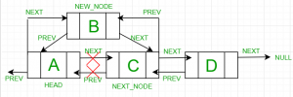
Add a node before a node

Slide 90
Add a node before a node
Let the pointer to this given node be next_node and the data of the new node to be added as new_data.
Check if the next_node is NULL or not. If it’s NULL, return from the function because any new node can not be added before a NULL
Allocate memory for the new node, let it be called new_node
Set new_node->data = new_data
Check for empty list
Set the previous pointer of this new_node as the previous node of the next_node, new_node->prev = next_node->prev
Set the previous pointer of the next_node as the new_node, next_node->prev = new_node
Set the next pointer of this new_node as the next_node, new_node->next = next_node;
If the previous node of the new_node is not NULL, then set the next pointer of this previous node as new_node, new_node->prev->next = new_node
Else, if the prev of new_node is NULL, it will be the new head node. So, make (*head_ref) = new_node.

Slide 91
Deletion from a Linked List
1. Deletion from beginning
2. Deletion at the end
3. Deleting a node other than the first and the last node

Slide 92
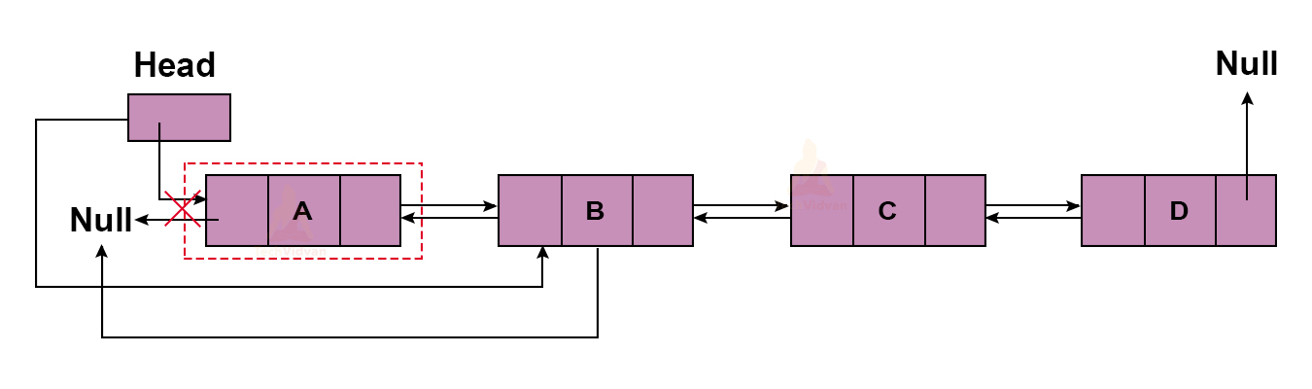
Deletion from the beginning
Algorithm to delete node from beginning
%% Input: head {Pointer to first node of the linked list}
Begin:
If (head == NULL) then
write ('Can't delete from an empty list')
End if
Else then
toDelete ← head;
head ← head.next;
head.prev ← NULL;
unalloc (toDelete)
write ('Successfully deleted first node from the list')
End if
End

Slide 93
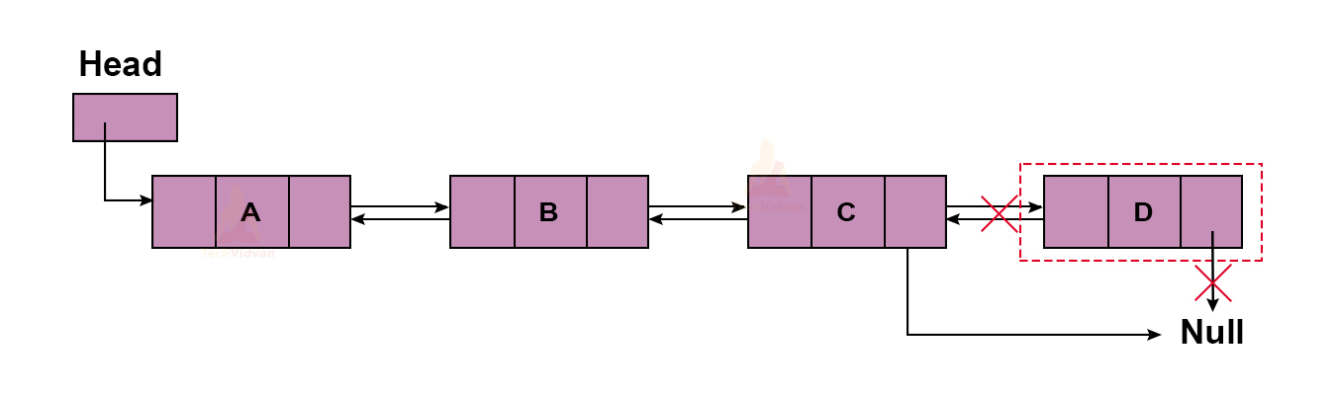
Deletion at the end
Algorithm to delete node from end
%% Input: last {Pointer to last node of the linked list}
Begin:
If (last == NULL) then
write ('Can't delete from an empty list')
End if
Else then
toDelete ← last;
last ← last.prev;
last.next ← NULL;
unalloc (toDelete)
write ('Successfully deleted last node from the list')
End if
End

Slide 94
Algorithm to delete node from any position of a doubly linked list
Algorithm to delete node from any position
%% Input : head {Pointer to the first node of the list}
last {Pointer to the last node of the list}
N {Position to be deleted from list}
Begin:
current ← head;
For i ← 1 to N and current != NULL do
current ← current.next;
End for
If (N == 1) then
deleteFromBeginning()
End if
Else if (current == last) then
deleteFromEnd()
End if
Else if (current != NULL) then
current.prev.next ← current.next
If (current.next != NULL) then
current.next.prev ← current.prev;
End if
unalloc (current)
write ('Node deleted successfully from ', N, ' position')
End if
Else then
write ('Invalid position')
End if
End

Slide 95
Defining a node
typedef struct node//defining structure node
{
int data;
struct node *link;
}node;

Slide 96
Creation of new node
//creates a new node
node *create()
{
node *temp=(node*)malloc(sizeof(node));
printf("enter data\n");
scanf("%d",&temp->data);
temp->link=NULL;
size++;
return temp;
}

Slide 97
Traverse to a node in the list
node *traverse(node *start,int pos)
{
int i=1;
do
{
i++;
start=start->link;
}while(i<pos);
return start;
}

Slide 98
Insert after a node
//inserts node after curr node
void insert(node *curr)
{
node *temp=create();
temp->link=curr->link;
curr->link=temp;
}

Slide 99
Insert at the beginning
node *insert_start(node *start, node *end)
{
//printf("%d\n",start->data);
node *curr=create();
curr->link=start;
start=curr;
end->link=start;
return start;
}

Slide 100
Insert at the end
node *insert_end(node *start, node *end)
{
node *curr=create();
end->link=curr;
curr->link=start;
end=curr;
return end;
}

Slide 101
Traverse
void display(node *start, int size)
{
node *temp=start;int i=1;
printf("\ncircular linkedlist\n");
if(size==0)
{
printf("List Empty\n");
return;
}
do
{
i++;
printf("%d\n",start->data);
start=start->link;
}while(start!=temp&&i<=size);
printf("\n");
}

Slide 102
Delete a node at given location
void delete(node *start,node *end,int pos)
{
node *temp,*temp2;
temp=traverse(start,pos);//traverses to prev node from current pos
temp2=temp->link;//set to next node from pos
temp->link=temp2->link;//connection of prev to next node
free(temp2);
size--;
display(start);
}

Slide 103
Delete from beginning
node *delete_from_beg(node *start,node *end)
{
node *temp;
if(size==1)//to delete remaining one element in list since both are linked to each other
{
// free(start);
/+/ free(end);
size--;
start=end=NULL;
display(start);
return NULL;
}
else
{
temp=start;
start=start->link;
end->link=start;
free(temp);
size--;
display(start);
return start;
}
}

Slide 104
Delete from end
node *delete_from_end(node *start,node *end)
{
node *temp;
if(size==1)
{
start=delete_from_beg(start,end);
return start;
}
else
{
temp=traverse(start,size-1);
temp->link=start;
free(end);
end=temp;
size--;
display(start);
return end;
}
}

